Slide 1

Physics 1
Voronkov Vladimir Vasilyevich

Slide 2
Lecture 4
Rotation of rigid bodies.
Angular momentum and torque.
Properties of fluids.

Slide 3
Rotation of Rigid Bodies in General case
When a rigid object is rotating about a fixed axis, every particle of the object rotates through the same angle in a given time interval and has the same angular speed and the same angular acceleration. So the rotational motion of the entire rigid object as well as individual particles in the object can be described by three angles. Using these three angles we can greatly simplify the analysis of rigid-object rotation.

Slide 4
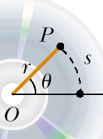
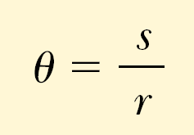
Radians
Angle in radians equals the ratio of the arc length s and the radius r:

Slide 5
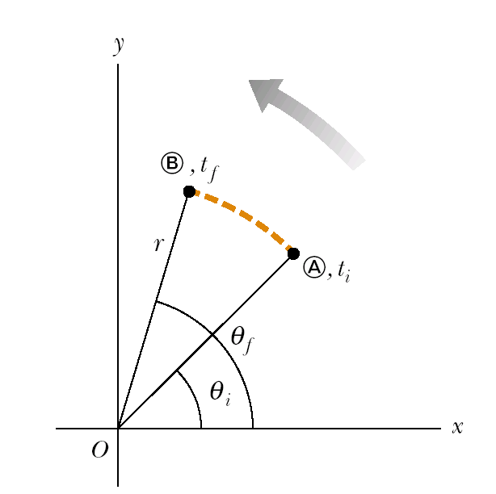


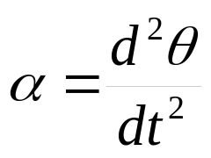

Angular kinematics
Angular displacement:
Instantaneous angular speed:
Instantaneous angular acceleration:
a

Slide 6
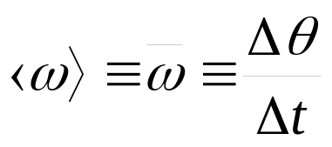
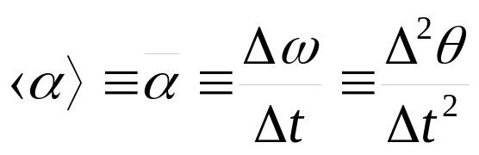
Average angular speed:
Average angular acceleration:

Slide 7

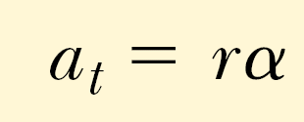

Angular and linear quantities
Every particle of the object moves in a circle whose center is the axis of rotation.
Linear velocity:
Tangential acceleration:
Centripetal acceleration:

Slide 8
Total linear acceleration
Tangential acceleration is perpendicular to the centripetal one, so the magnitude of total linear acceleration is

Slide 9
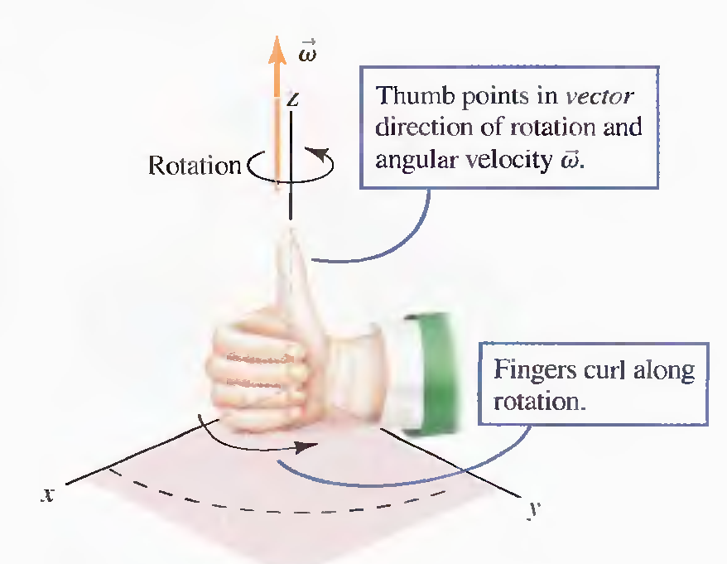
Angular velocity
Angular velocity is a vector.
The right hand rule is applied: If the fingers of your right hand curl along with the rotation your thumb will give the direction of the angular velocity.

Slide 10

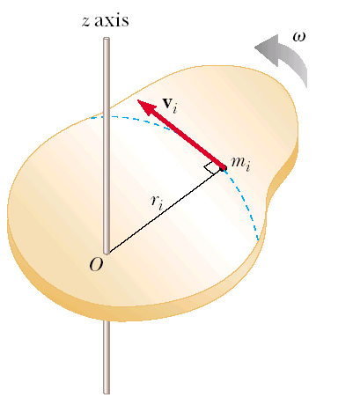
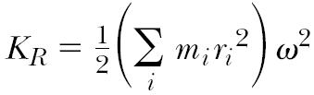
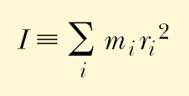
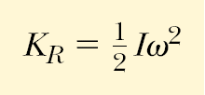
Rotational Kinetic Energy
Moment of rotational inertia
Rotational kinetic energy

Slide 11
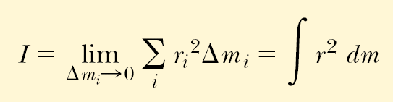
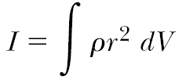
Calculations of Moments of Inertia

Slide 12
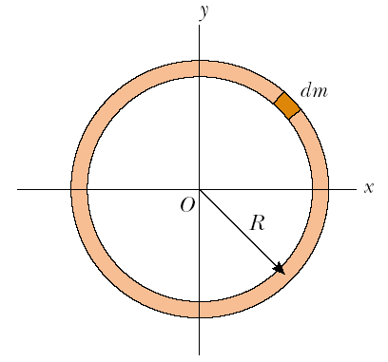
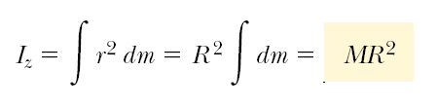
Uniform Thin Hoop

Slide 13
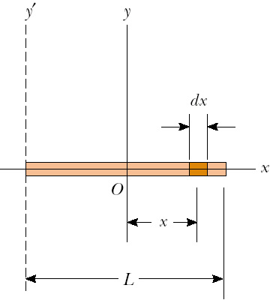

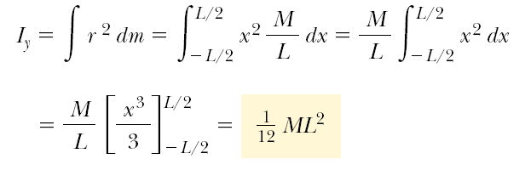
Uniform Rigid Rod

Slide 14



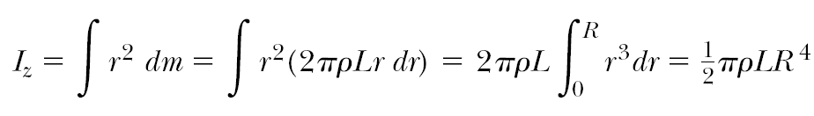
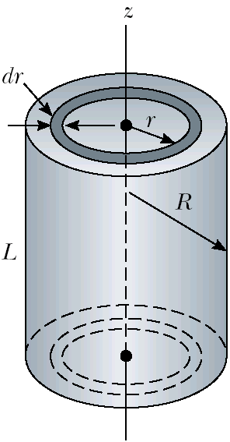


Uniform Solid Cylinder

Slide 15
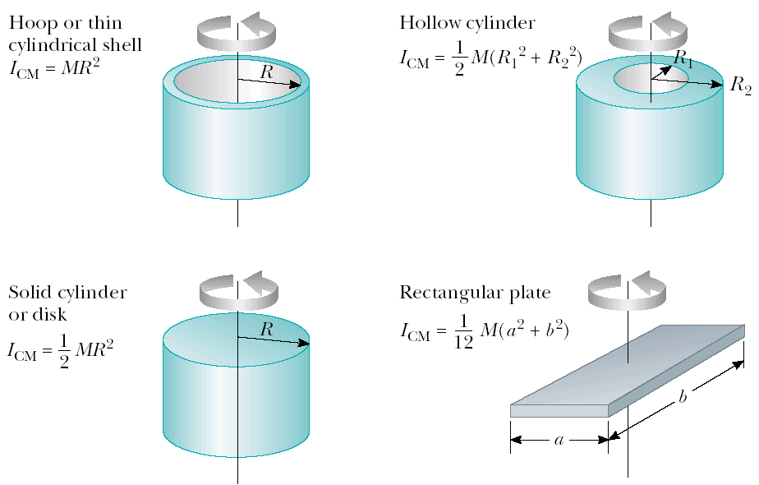
Moments of Inertia of Homogeneous Rigid Objects with Different Geometries

Slide 16
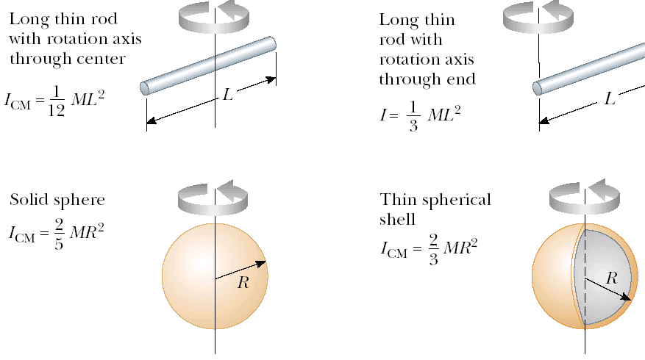

Slide 17

Parallel-axis theorem
Suppose the moment of inertia about an axis through the center of mass of an object is I_{CM}. Then the moment of inertia about any axis parallel to and a distance D away from this axis is

Slide 18
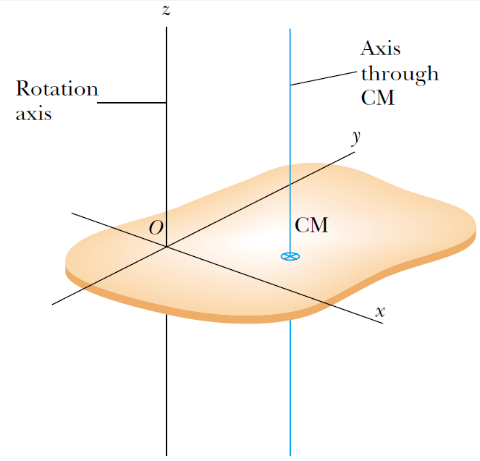

Slide 19
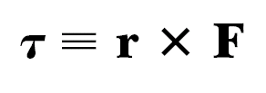
Torque
When a force is exerted on a rigid object pivoted about an axis, the object tends to rotate about that axis. The tendency of a force to rotate an object about some axis is measured by a vector quantity called torque τ (Greek tau).

Slide 20
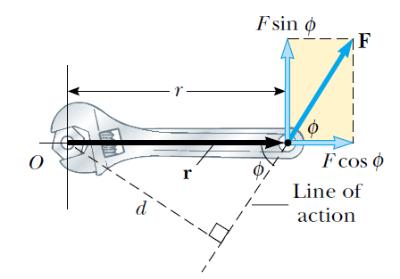
The force F has a greater rotating tendency about axis O as F increases and as the moment arm d increases. The component F sinφ tends to rotate the wrench about axis O.

Slide 21
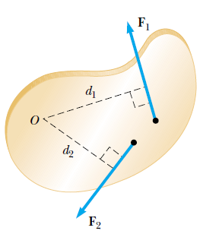
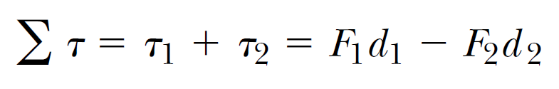
The force F₁ tends to rotate the object counterclockwise about O, and F₂ tends to rotate it clockwise.
We use the convention that the sign of the torque resulting from a force is positive if the turning tendency of the force is counterclockwise and is negative if the turning tendency is clockwise. Then

Slide 22
Torque is not Force
Torque is not Work
Torque should not be confused with force. Forces can cause a change in linear motion, as described by Newton’s second law. Forces can also cause a change in rotational motion, but the effectiveness of the forces in causing this change depends on both the forces and the moment arms of the forces, in the combination that we call torque. Torque has units of force times length—newton · meters in SI units—and should be reported in these units.
Do not confuse torque and work, which have the same units but are very different concepts.

Slide 23






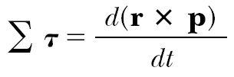

Rotational Dynamics
Let’s add which equals zero, as
and are parallel.
Then: So we get

Slide 24
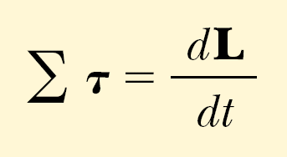
Rotational analogue of Newton’s second law
Quantity L is an instantaneous angular momentum.
The torque acting on a particle is equal to the time rate of change of the particle’s angular momentum.

Slide 25
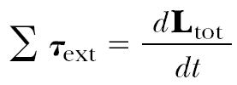
Net External Torque
The net external torque acting on a system about some axis passing through an origin in an inertial frame equals the time rate of change of the total angular momentum of the system about that origin:

Slide 26

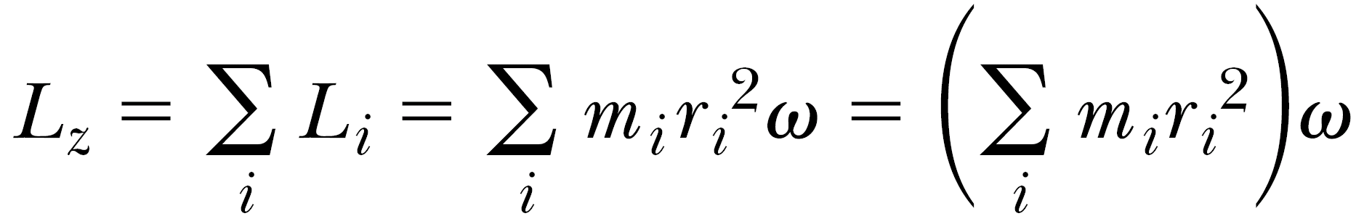
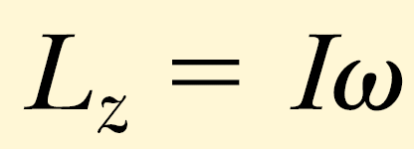
Angular Momentum of a Rotating Rigid Object
Angular momentum for each particle of an object:
Angular momentum for the whole object:
Thus:

Slide 27

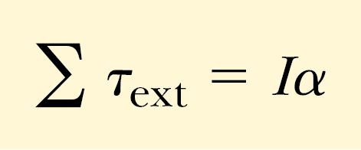
Angular acceleration

Slide 28


The Law of Angular Momentum Conservation
The total angular momentum of a system is constant if the resultant external torque acting on the system is zero, that is, if the system is isolated.

Slide 29

Change in internal structure of a rotating body can result in change of its angular velocity.

Slide 30
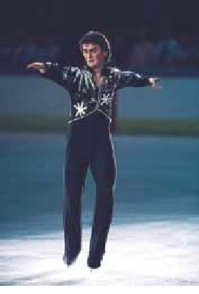

When a rotating skater pulls his hands towards his body he spins faster.

Slide 31
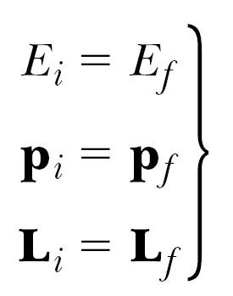
Three Laws of Conservation for an Isolated System
Full mechanical energy, linear momentum and angular momentum of an isolated system remain constant.

Slide 32

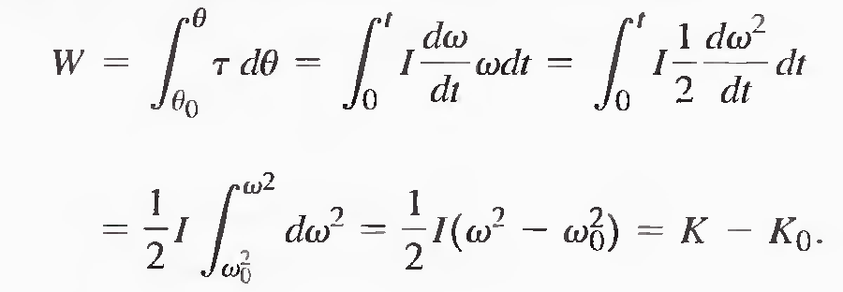
Work-Kinetic Theory for Rotations
Similarly to linear motion:

Slide 33
The net work done by external forces in rotating a symmetric rigid object about a fixed axis equals the change in the object’s rotational energy.

Slide 34
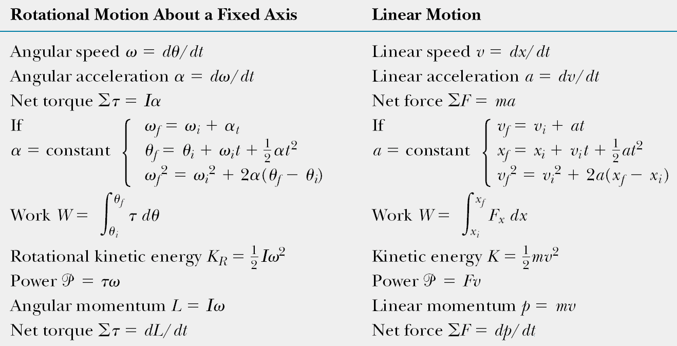
Equations for Rotational and Linear Motions

Slide 35
Independent Study for IHW2
Vector multiplication (through their components i,j,k).Right-hand rule of Vector multiplication.
Elasticity
  Demonstrate by example and discussion your understanding of elasticity, elastic limit, stress, strain, and ultimate strength.
  Write and apply formulas for calculating Young’s modulus, shear modulus, and bulk modulus. Units of stress.

Slide 36
Fluids
  Define absolute pressure, gauge pressure, and atmospheric pressure, and demonstrate by examples your understanding of the relationships between these terms.
  Pascal’s law.
  Archimedes’s law.
  Rate of flow of a fluid.
  Bernoulli’s equation.
  Torricelli’s theorem.

Slide 37
Literature to Independent Study
Lecture on Physics Summary by Umarov. (Intranet)
Fishbane Physics for Scientists… (Intranet)
Serway Physics for Scientists… (Intranet)

Slide 38
Problems
A solid sphere and a hollow sphere have the same mass and radius. Which momentum of rotational inertia is higher if it is? Prove your answer with formulae.
What are the units for, are these quantities vectors or scalars:
  Angular momentum
  Angular kinetic energy
  Angular displacement
  Tangential acceleration
  Angular acceleration
  Torque

